Slide 1
Strassen’s Matrix Algorithm
GROUP MEMBERS :
RAHUL ROY (IIT2019194)
DEEPTARSHI BISWAS (IIT2019195)
CHETAN PATIDAR (IIT2019193)

Slide 2
Abstract
The project aims at implementing Strassen’s Algorithm and understanding the advantages and limitations of this method and developing an overall idea of it’s practical significance. We look at two approaches and compare the complexity of both.

Slide 3
Contents
Introduction
Algorithmic Design
Algorithmic Analysis
Time Complexity for all approaches
Conclusion
References

Slide 4
INTRODUCTION
In this project or presentation, we are going to analyze Strassen’s matrix multiplication algorithm and deduce it’s practical importance and use along with it’s advantages and limitations.
Let us consider two matrices X and Y. We are required to calculate the resultant matrix Z by multiplying both X and Y. Matrix multiplication is a binary operationon two matrices that produces a single resultant matrix.
For matrix multiplication, the number of columns in the first matrix must be equal to the number of rows in the second matrix. For example let A be a matrix of size m*n and B be a matrix of size x*y. Then matrix multiplication is acheived only if n==x and the resultant matrix C=A*B is of size m*y.
Thus the product XY is defined if and only if the number of columns in X equals the number of rows in Y.The utility of Strassen's formula is shown by its asymptotic superiority when order n of matrix reaches infinity.

Slide 5
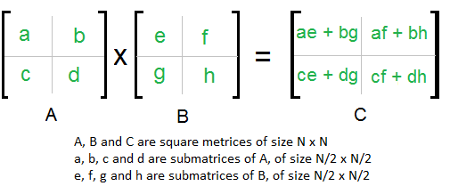
ALGORITHMIC DESIGN
First Approach ( Naive Approach) (Dividing each matrix into 4 smaller matrices and performing multiplication):
Divide matrices A and B in 4 sub-matrices of size (n/2) x (n/2)
Calculate following values Recursively: ae+bg , af+bh , ce + dg and cf+dh

Slide 6
Naive Approach:
matrix multiply( matrix A, matrix B, int n)
{
//base case
if(n==1)return A[0][0]*B[0][0];
//break matrix A and B into 4 quadrants
matrix a,b,c,d //for matrix A
matrix e,f,g,h; //for matrix B
int k = (n/2);
matrix C;
matrix c1,c2,c3,c4 //4 quadrants of matrix C
c1 = multiply(a,e,k) + multiply(b,g,k)
c2 = multiply(a,f,k) + multiply(b,h,k)
c3 = multiply(c,e,k) + multiply(d,g,k)
c4 = multiply(d,f,k) + multiply(d,h,k)
return C;
}

Slide 7
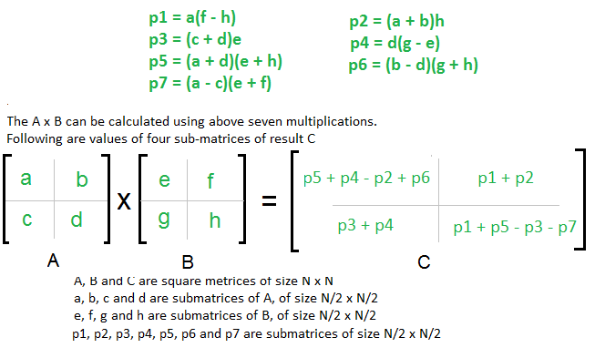
ALGORITHMIC DESIGN
Approach 2 (Strassens’ algorithm):

Slide 8
Algorithm
matrix multiply( matrix A, matrix B, int n)
{
//base case
if(n==1)return A[0][0]*B[0][0];
//break matrix A and B into 4 quadrants
matrix a,b,c,d //for matrix A
matrix e,f,g,h; //for matrix B
int k = (n/2);
matrix C;
matrix c1,c2,c3,c4 //4 quadrants of matrix C
matrix p1,p2,p3,p4,p5,p6,p7
p1 = multiply(a,f-h,k), p2 = multiply(a+b,h,k),
p3 = multiply(c+d,e,k), p4 = multiply(d,g-e,k),
p5 = multiply(a+d,e+h,k), p6 = multiply(b-d, g+h,k),
p7 = multiply(a-c, e+f,k),
c1 = p5+p4-p2+p6
c2 = p1+p2
c3 = p3+p4
c4 = p1+p5-p3-p7
return C;
}

Slide 9
ALGORITHM ANALYSIS
Naive Approach:
The above described algorithm to divide the array into smaller components takes O(n*n*n) time complexity in both the best and worst cases. Space complexity = O(logn*n*n)
t_{best}: when n=0, = O(0) = 0 ms
t_{worst}: when n=50 , t_{worst} = O(125000)
Strassens’ Algo:
Addition and Subtraction of two matrices takes $O(N^2)$ time. So time complexity can be written as:
T(N) = 7T(N/2) + O(N^2) = O(N^log7) = O(N^2.8) time.
Space = O(logn* n^2)
t_{best}: when n=0, = O(0) = 0 ms
t_{worst} : when n=50 ,

Slide 10
VALUES OF O(N) FOR BOTH ALGORITHMS
S.No | n | Approach 1 | Approach 2
1 | 0 | 0 | 0
2 | 10 | 1000 | 88.28972194
3 | 50 | 125000 | 2023.219371
4 | 100 | 1000000 | 7795.075
5 | 1000 | 1000000000 | 688225.0043
6 | 10000 | 1000000000000 | 60763194.26

Slide 11
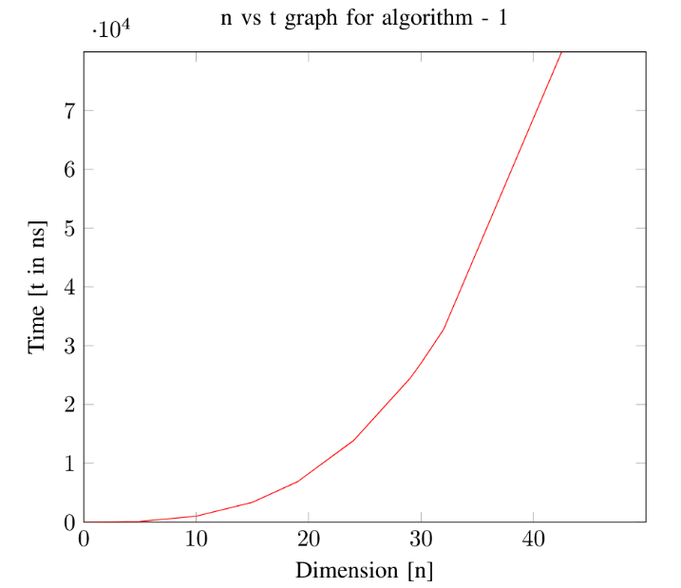
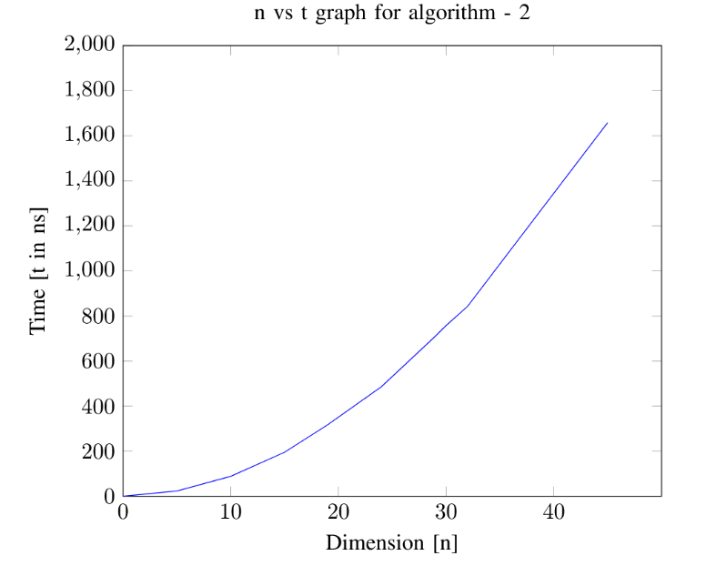
TIME COMPLEXITIES OF ALGO 1 & 2
NAIVE APPROACH
STRASSEN’S ALGORITHM

Slide 12
CONCLUSION
Though the implementation of Strassen's algorithm for matrix multiplication is faster than the naive method for matrix multiplication, if applied on large enough matrices but still it has not got amny practical significance dur to the following reasons : 1) The constants used in Strassen’s method are high and for a typical application naive method works better. 2) For Sparse matrices, there are better methods especially designed for them. 3) The sub-matrices in recursion take extra space. 4) Because of the limited precision of computer arithmetic on non-integer values, larger errors accumulate in Strassen’s algorithm than in Naive Method

Slide 13
Reference
. https://en.wikipedia.org/wiki/Subsequence
. https://www.geeksforgeeks.org/longest-increasing-subsequence-dp-3/
. ​https://www2.cs.duke.edu/courses/spring18/compsci330/Notes/dynamic.pdf

